Slide 1
SE 2101 Software Engineering
Chapter 3
Software Engineering, A Practitioner’s Approach, Pressman R. S.& Maxim B. R., 7th Edition, McGraw-Hill, 2015.

Slide 2
Today’s Agenda
Agile Models
  XP Programming

Slide 3
Agile Development

Slide 4
Common Fears for Developers
The project will produce the wrong product.
The project will produce a product of inferior quality.
The project will be late.
We’ll have to work 80-hour weeks.
We’ll have to break commitments.
We won’t be having fun.

Slide 5
What is “Agility”?
Effective (rapid and adaptive) response to change
Effective communication among all stakeholders
Drawing the customer onto the team
Organizing a team so that it is in control of the work performed
Yielding …
Rapid, incremental delivery of software

Slide 6
An Agile Process
Is driven by customer descriptions of what is required (scenarios)
Recognizes that plans are short-lived
Develops software iteratively with a heavy emphasis on construction activities
Delivers multiple ‘software increments’
Adapts as changes occur

Slide 7
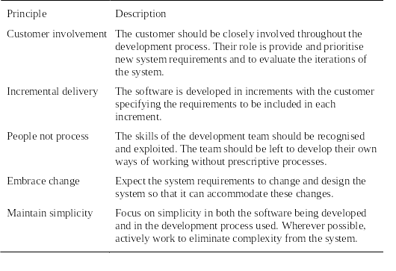
Principles of agile methods

Slide 8
Agile process models (in this course)
Extreme Programming (XP)
Scrum

Slide 9
Extreme Programming (XP)
Perhaps the best-known and most widely used agile method.
Extreme Programming (XP) takes an ‘extreme’ approach to iterative development.
  New versions may be built several times per day;
  Increments are delivered to customers every 2 weeks;
  All tests must be run for every build and the build is only accepted if tests run successfully.
XP Values
  Communication
  Simplicity
  Feedback
  Courage
  Respect

Slide 10
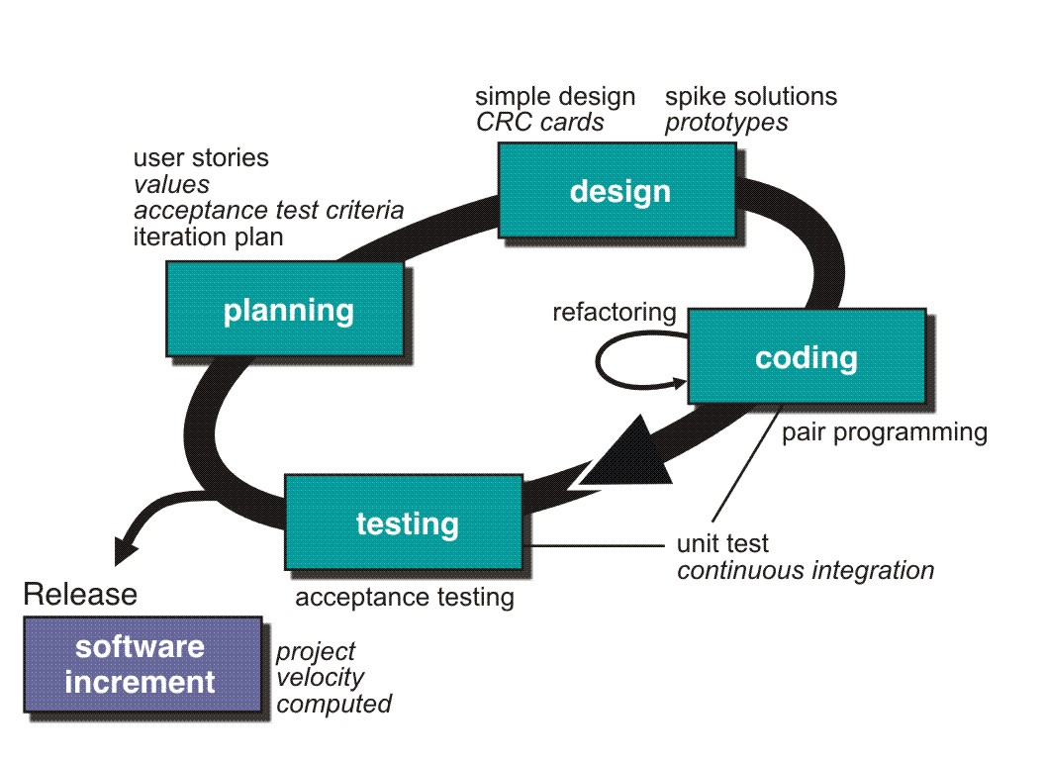
Extreme Programming (XP)

Slide 11
Extreme Programming (XP)
XP Planning
  Begins with the creation of user stories
  Agile team assesses each story and assigns a cost
  Stories are grouped to form a deliverable increment
  A commitment is made on delivery date
  After the first increment project velocity is used to help define subsequent delivery dates for other increments

Slide 12
Extreme Programming (XP)
XP Design
  Follows the KIS (keep it simple) principle
  Encourage the use of CRC (Class-Responsibility-Collaboration) cards
  For difficult design problems, suggests the creation of spike solutions — a design prototype
  Encourages refactoring — an iterative refinement of the internal program design
XP Coding
  Recommends the construction of a unit test for a story before coding starts
  Encourages pair programming

Slide 13
Extreme Programming (XP)
XP Testing
  All unit tests are executed daily
  Acceptance tests are defined by the customer and executed to assess customer visible functionality

Slide 14
XP and agile principles
Incremental development is supported through small, frequent system releases.
Customer involvement means full-time customer engagement with the team.
People not process through pair programming, collective ownership and a process that avoids long working hours.
Change supported through regular system releases.
Maintaining simplicity through constant refactoring of code.

Slide 15
Customer involvement
Customer involvement is a key part of XP where the customer is part of the development team.
The role of the customer is:
  To help develop stories that define the requirements
  To help prioritize the features to be implemented in each release
  To help develop acceptance tests which assess whether the system meets its requirements or not.

Slide 16
Requirements scenarios
In XP, user requirements are expressed as scenarios or user stories.
These are written on cards and the development team break them down into implementation tasks. These tasks are the basis of schedule and cost estimates.
The customer chooses the stories for inclusion in the next release based on their priorities and the schedule estimates.

Slide 17
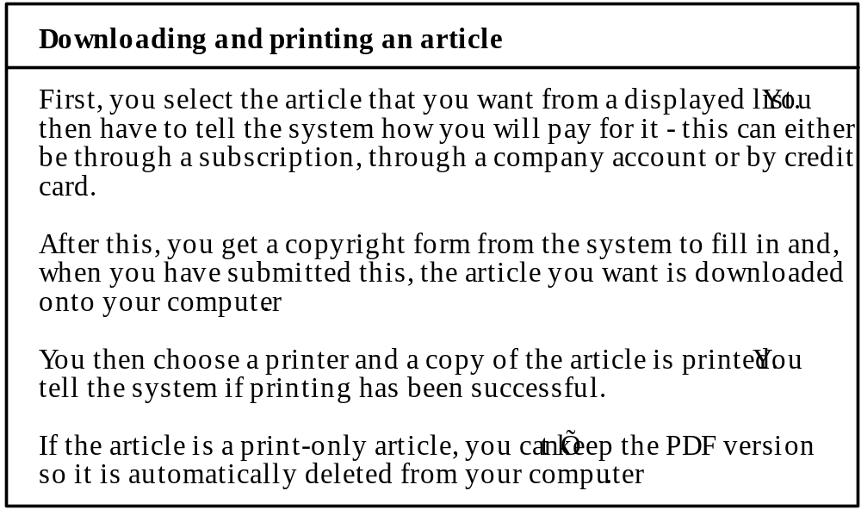
Story card for document downloading

Slide 18
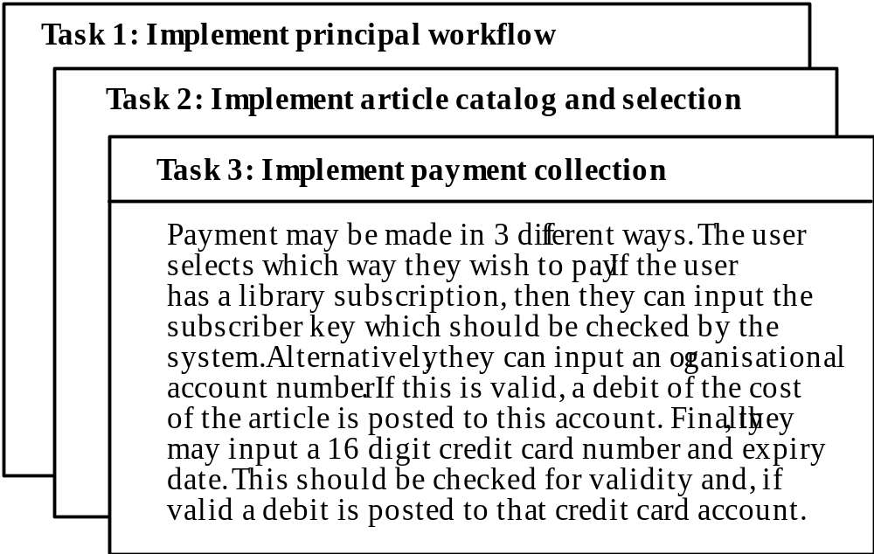
Task cards for document downloading

Slide 19
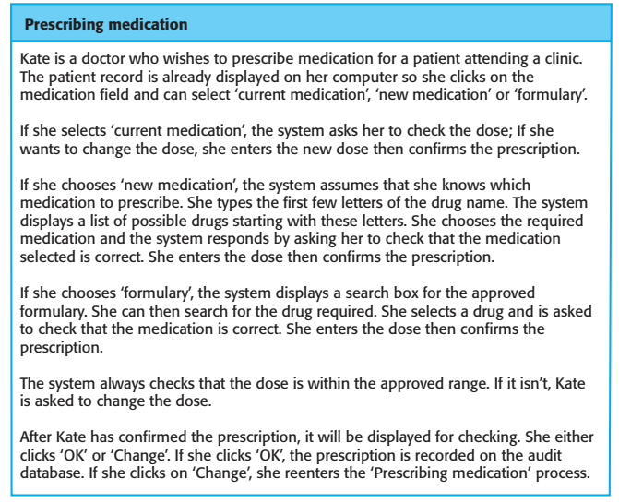
Chapter 3 Agile software development

Slide 20
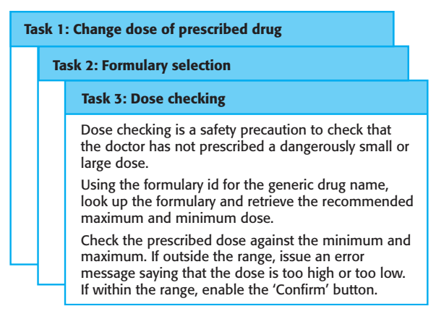
Task cards

Slide 21
XP and change
Conventional wisdom in software engineering is to design for change. It is worth spending time and effort anticipating changes as this reduces costs later in the life cycle.
Rather, it proposes constant code improvement (refactoring) to make changes easier when they have to be implemented.

Slide 22
Refactoring
Refactoring is the process of code improvement where code is reorganized and rewritten to make it more efficient, easier to understand, etc.
Refactoring is required because frequent releases mean that code is developed incrementally and therefore tends to become messy.
Refactoring should not change the functionality of the system.
Refactoring becomes easier with automated testing, as it allows you to verify whether the modified code still passes all tests successfully..

Slide 23
Testing in XP
Test-first development.
Incremental test development from scenarios.
User involvement in test development and validation.
Automated test systems run all component tests whenever a new release is built.

Slide 24
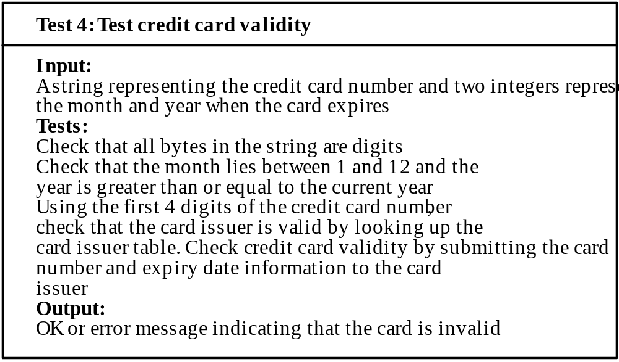
Test case description

Slide 25
Test-first development
Writing tests before code clarifies the requirements to be implemented.
Tests are written as programs rather than data so that they can be executed automatically. The test includes a check that it has executed correctly.
All previous and new tests are automatically run when new functionality is added. Thus checking that the new functionality has not introduced errors.

Slide 26
Pair programming
In XP, programmers work in pairs, sitting together to develop code.
This helps develop common ownership of code and spreads knowledge across the team.
It serves as an informal review process as each line of code is looked at by more than 1 person.
It encourages refactoring as the whole team can benefit from this.
Measurements suggest that development productivity with pair programming is like that of two people working independently.

Slide 27
The End.

